Slide 1
Sentiment analysis with Large Language Models for predicting trends in Bitcoin
Supervisor: Prof. Anil Kokaram, Dr. Claire Gallagher
May.21 2025
Ziang Liu 24333476

Slide 2
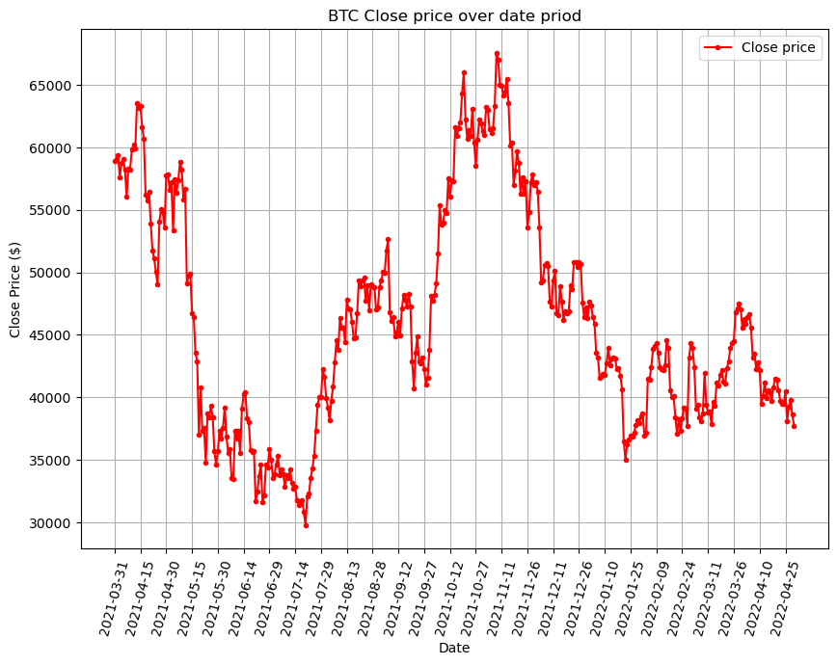
Introduction and Aim
Date | News title
2021-3-31 | Iphone user loses $ 600,000 downloading scam bitcoin app apple store
2021-3-31 | New app help previously incarcerated individual find job
2021-3-31 | Bitcoin ether hit highest since mid - may sentiment warms
2021-4-1 | Rise bot trading world cryptocurrency
2021-4-2 | Art nft question : next frontier trading , new form tulip ?
...... | ........

Slide 3
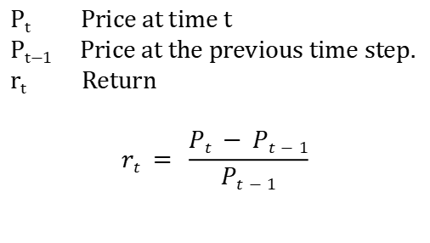
Introduction and Aim
Trading signal
P_{t}
An actionable indicator that suggests when to buy, sell, or hold an asset.
Buy signal
Sell signal
Return
P_{t} Price at time t
P_{t−1} Price at the previous time step.
r_{t} Return
$$rt = \frac{Pt − Pt−1}{Pt−1}$$
P_{t-1}

Slide 4
Introduction and Aim
This work explores the use of financial news headlines for predicting bitcoin price trends through automated sentiment analysis.
Sentiment analysis performance is evaluated by generating trading signals based on sentiment and measuring the resulting returns.
Integrates machine learning theory with real-world business data
Better asset management, Algorithmic trading
Notes:
it suggests a data driven method that helps address the limitations of traditional financial models in processing unstructured textual data, improving the accuracy of market predictions. Importance of addressing these challenges for advancing AI technology. integrates advanced machine learning theory with real-world business data

Slide 5
Objectives
Review existing literature on LLMs in financial predictions
Replicate FinBERT(LLM)’s performance on the GDELT news database
Retrain and implement FinBERT to improve sentiment analysis accuracy
Evaluate FinBERT’s performance using statistical and financial metrics
Calculate correlation between sentiment and returns
Develop a trading signal based on sentiment analysis

Slide 6
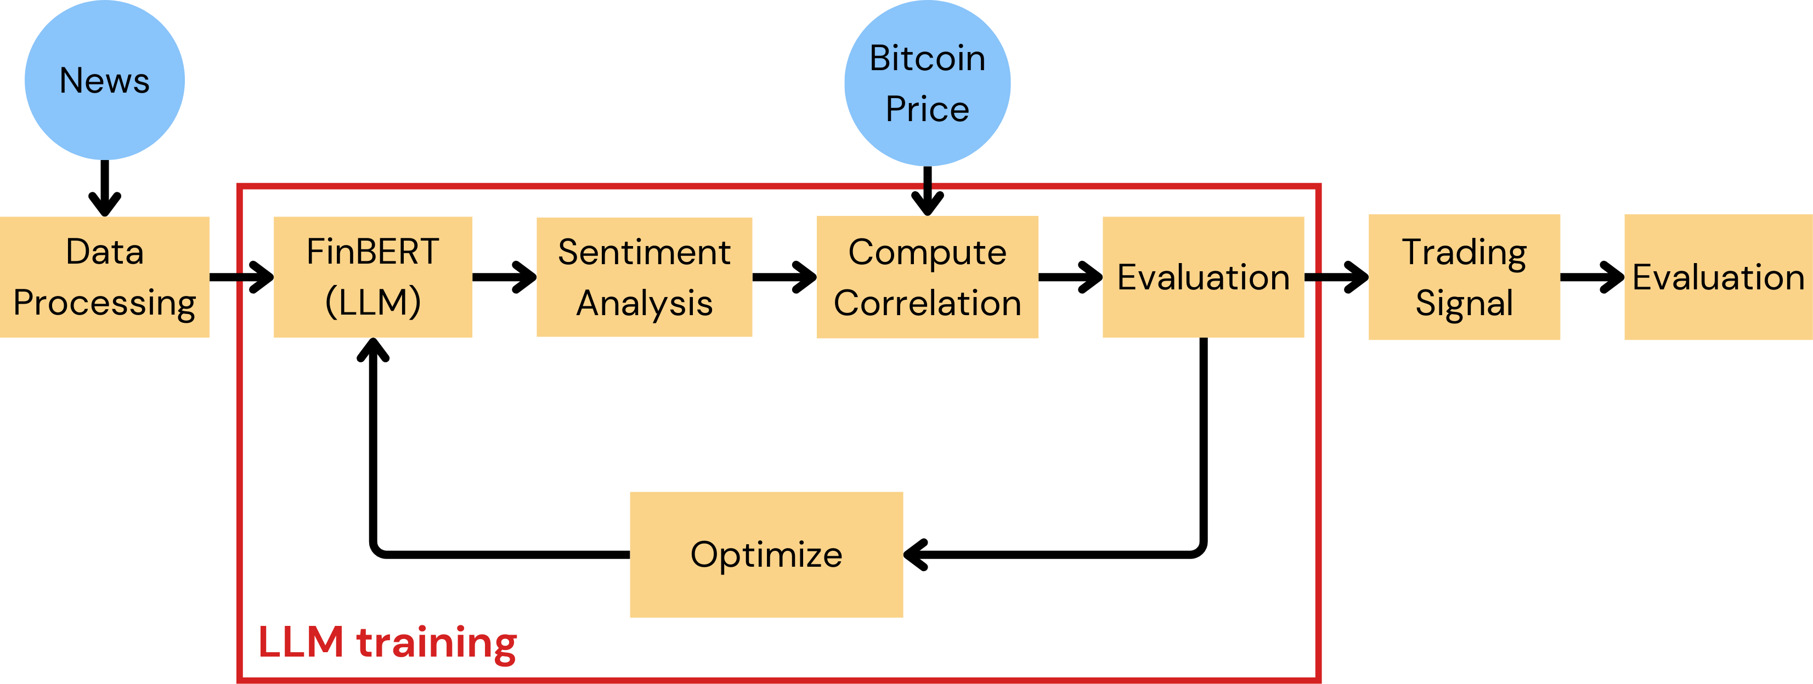
Method

Slide 7
Data
243504 News titles were extracted from GDELT between March 2021 and April 2022 containing any of the key words: cryptocurrency, cryptocurrencies, CBDC, Bitcoin, Ethereum, Litecoin, BitcoinCash...[1]
Global Data on Events, Location and Tone (GDELT) contains over 200 million geolocated events with worldwide coverage from 1979 to the present.
Bitcoin price is downloaded from CoinMarketCap covering the same date period.
[1] Alonso, F., & Sicilia, M. Á. (2022, October). Cryptocurrency curated news event database from GDELT. Research Square.

Slide 8

FinBERT - Large Language Model
FinBERT is trained over 61 GB of text data, with approximately 12.7 billion words from financial sources and 3.3 billion words from general sources.
ethereum expected hit new high
S_{pos} = 0.98
S_{neu} = 0.01
S_{neg} = 0.01

Slide 9
Retrain FinBERT
The original FinBERT model has an accuracy of 64.8% on a manually labeled GDELT news dataset consisting of 600 news articles.
Retrain:
1. Remove the stop words. ("the", "and", "is")
2. Remove punctuation and special characters
3. Convert all text to lower case
4. lemmatizes each word
Retrained FinBERT has 85% accuracy on test set
Train 70%
Validation 20%
Test 10%
Learning rate 2e-5
Batch size 8
Weight decay 0.01

Slide 10
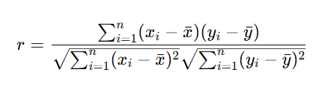
Sentiment Analysis
To build the trading signal, we need to understand the relationship between the Sentiment signal and the Return signal
Pearson correlation can represent the strength and direction of the signals linear relationship.
Pearson Correlation
Daily Sentiment signal
Return signal
?
?
Sentiment score of each news
Bitcoin price

Slide 11
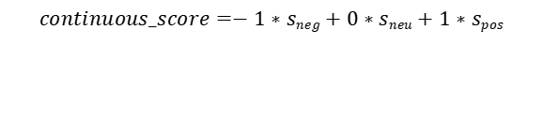
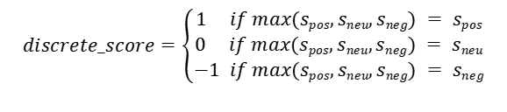


Sentiment Analysis
To compute daily sentiment, we aggregate individual news sentiment scores by day
$$discrete_score=\left\{\begin{aligned}1 if max(spos,sneu,sneg) = spos \\ 0 if max(spos,sneu,sneg) = sneu \\ −1 if max(spos,sneu,sneg) = sneg\end{aligned}\right.$$
S_{pos} = 0.98
S_{neu} = 0.01
S_{neg} = 0.01
discrete score = 1
continuous score = 0.97
$$continuous_score=−1∗sneg+0∗sneu+1∗spos$$
discrete_sum = -8
discrete_mean = -0.44
continuous_sum = -7.6
continuous_mean = -0.43
$$sigmoidt=σ(rt)= \frac{1}{1+e^{−rt}}$$
compute daily sentiment score
discrete_sum_sign = -1
continuous_sum_sigmoid
= 0.0005
$$sign(rt)=\left\{\begin{aligned}1 if rt>0 \\ 0 if rt=0 \\ −1 if rt<0\end{aligned}\right.$$
Daily sentiment signal

Slide 12
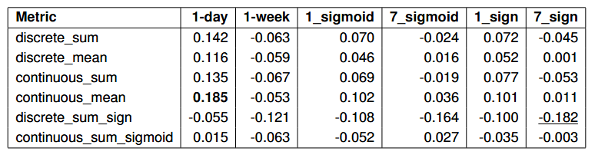


Pearson Correlation
Return signal
1 day return
1 week return
$$sigmoidt=σ(rt)= \frac{1}{1+e^{−rt}}$$
1_sigmoid
1_sign
7_sigmoid
7_sign
Bitcoin Price
$$sign(rt)=\left\{\begin{aligned}1 if rt>0 \\ 0 if rt=0 \\ −1 if rt<0\end{aligned}\right.$$
Return signal
Daily sentiment signal

Slide 13
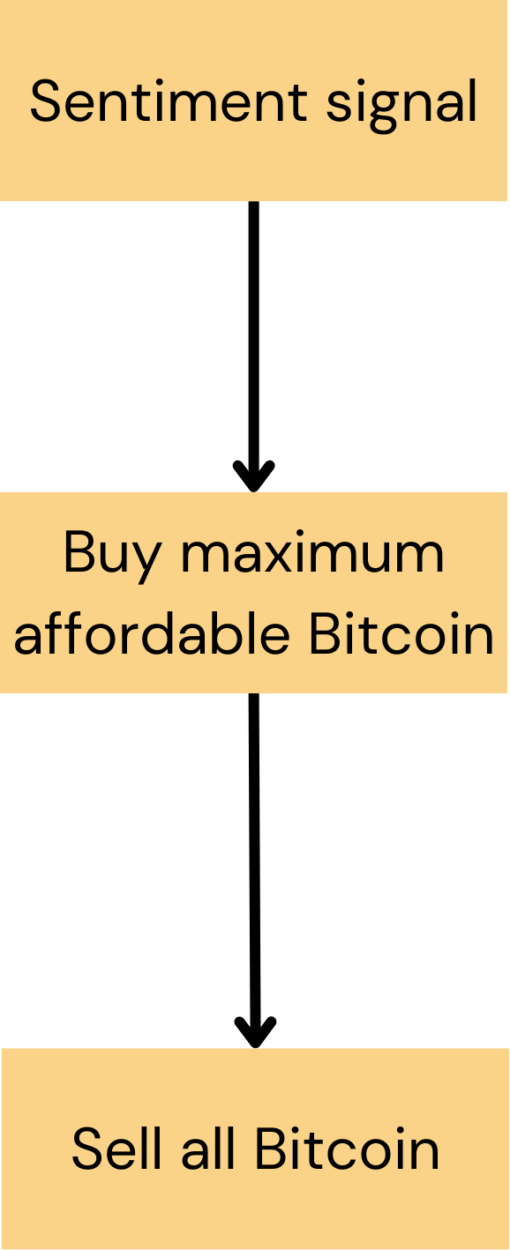
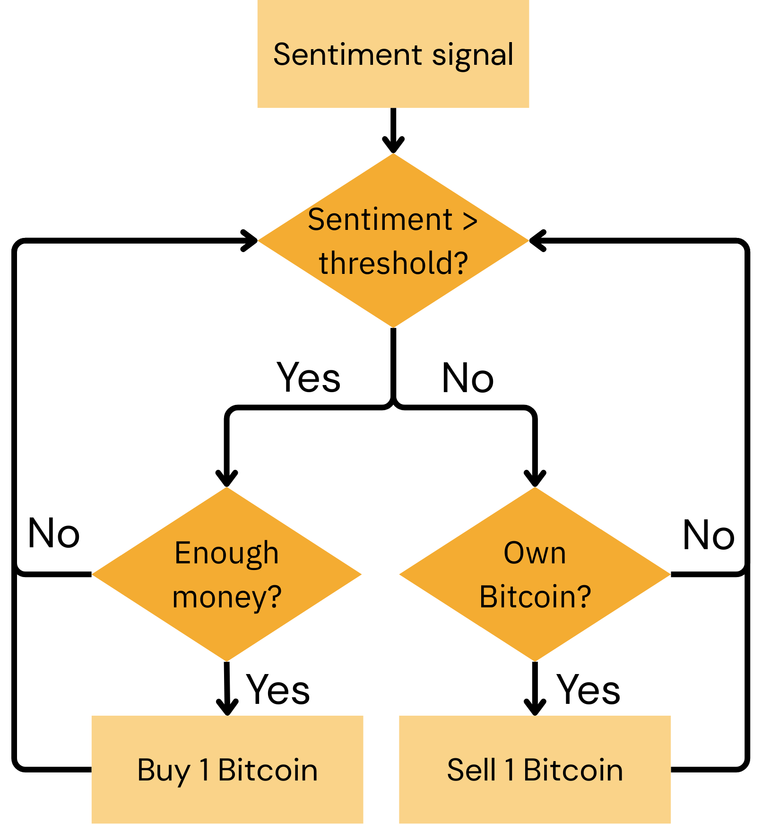
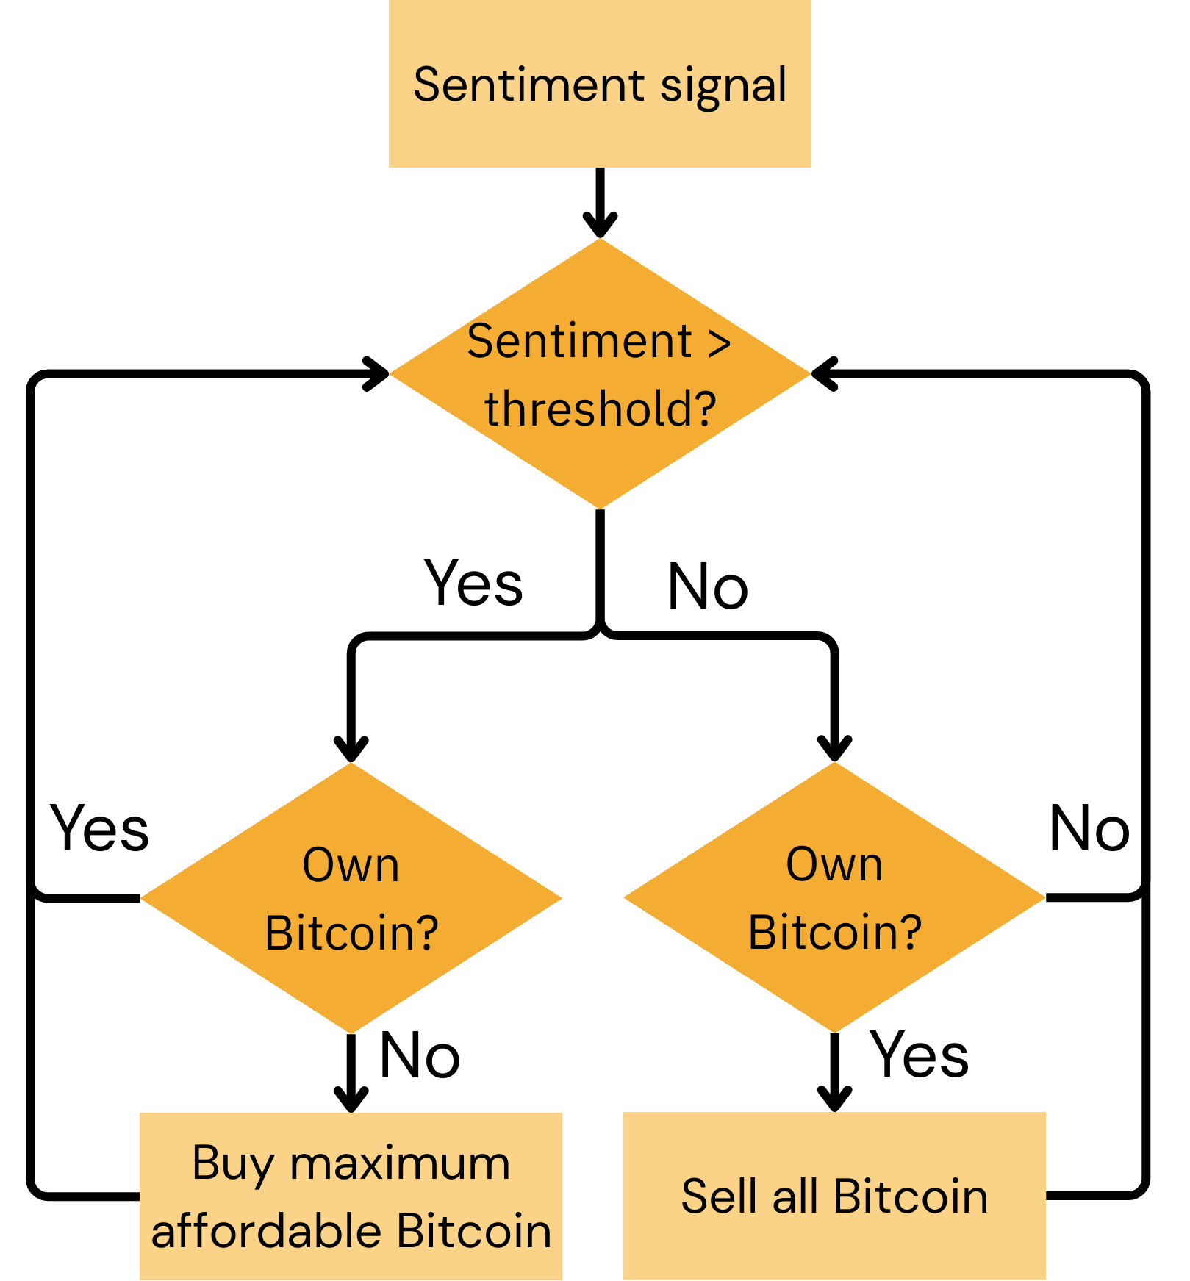
Development of trading algorithm
continuous_mean, Threshold (= 0.5), Start money (= €1,000,000)
Buy-and-hold Strategy
Sentiment Strategy 1
Sentiment Strategy 2

Slide 14
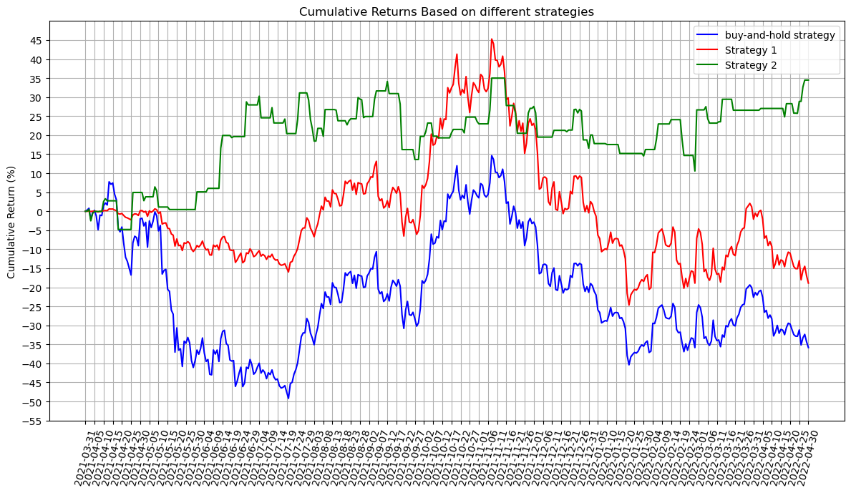
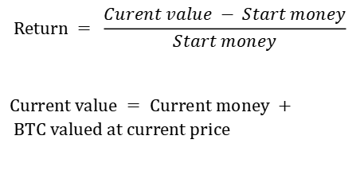
Performance
$$Return = \frac{Curent value − Start money}{Start money}$$
$Current value = Current money + BTC valued at current price$

Slide 15
Limitation
The price signal is highly noisy and influenced by multiple factors beyond sentiment
The dataset used to retrain FinBERT is imbalanced
The accuracy of the retrained FinBERT model remains a concern
Current sentiment strategy could be improved
Does not account for real-time price changes, transaction fees, and other trading costs.

Slide 16
Future work
Collect a more balanced and comprehensive news dataset
Consider other factors such as moving average, interest rate etc.
Enhance the performance of the retrained FinBERT model
Optimize the trading signal strategy for better return

Slide 17
Thank You

